Slide 1
Machine Learning
Course Introduction

Slide 2

About me
My name is Shahar Cohen.
I have Ph.D in Machine learning.
I was a Co-founder and the CTO of Optimove.com, an independent machine learning consultant for many years, a machine learning leader @ Intel and a co-Founder @ YellowRoad (a machine learning startup).
I am thrilled by new AI initiatives, and I think I can help them a lot.
Contact me: shahar@start-up.ai 0502007332

Slide 3
So, what is Machine Learning?

Slide 4
Machine Learning is an important area in Artificial Intelligence that deals with practices that apply to machines that learn from experience.
Learning from experience is important in automating decision making, without needing to pre-decide on the right reaction for every possible scenario

Slide 5
Learning from experience is important in automating decision making, without needing to pre-decide on the right reaction for every possible scenario
>> There might be too many possible scenarios
>> The best reaction might be unknown

Slide 6
AI, ML & Deep Learning

Slide 7
AI, ML & Deep Learning
“If it is written in Python it is Machine Learning, if it is presented in PowerPoint, it is AI”
Source unknown

Slide 8
What it takes to implement machine learning
Math & Statistics
IT / Engineering
Algorithms
Data Science
Traditional Software
Traditional Research
Business Knowledge

Slide 9
Machine Learning Software vs. Traditional Software?

Slide 10
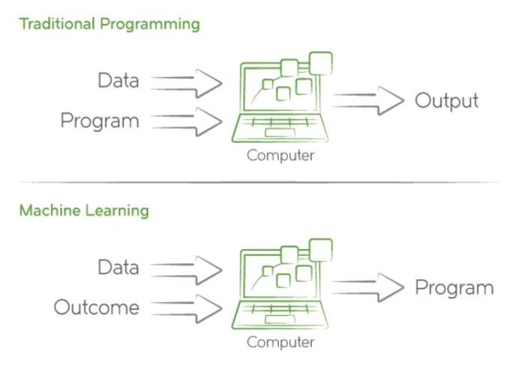

Slide 11
Traditional Software Development
Requirements
Design
Development
Testing
Deployment
Maintenance
Machine Learning Development
Research
Requirements
Design
...

Slide 12
Industry Examples
Recommendation systems like in Netflix or Amazon
Demand forecasting
Information retrieval (NLP scenarios)
Bid optimization in Adtech
Marketing optimization
Anomaly (e.g., fraud) detection
Image processing

Slide 13
Machine Learning in the Industry

Slide 14
Machine Learning in the Industry
Everybody is curious about it
Some really understand the potential
Few know how to materialize it
Very few really deliver
How are you going to fit in?

Slide 15
Becoming a Data Scientist
Data science is often referred to as the sexiest job of the 21st century, carrying a lot of responsibility on the evolvement of the human kind.
The industry needs a lot of data scientists.
Yet, getting into industry is not an easy task: lot of knowledge and experience is needed, lack of experienced professional to learn form, lack of standardization, many different kinds of data scientists

Slide 16
Course Outline

Slide 17
Course Outline
Introduction to machine learning
Project initiation: business definitions, data exploration & preparation
Modeling:
Supervised learning (including deep learning ?)
Unsupervised learning
Reinforcement learning (?)
Modeling evaluation
Deployment

Slide 18
Aligning Expectations
You will not become an experienced data scientists solely based on the course and you might find it hard to get a first job in the field.
But,
You will get a gentle yet non trivial introduction to the field, with ability to explore its possibilities hands on. Use this introduction wisely, continue to learn, maintain hands on capabilities, and I’m sure that good thigs will happen to you.

Slide 19
Aligning Expectations
We will not dive deep into the mathematics. I will try to provide good intuition.
We will work with Python – the de facto environment for data scientists.
You will get very little from the course without self practice: re-build the code that we share, read more on any important function, trial with its parameters, search for online examples, run them and understand them

Slide 20
Machine Learning
So let’s go

